Slide 1
CS1231
Tutorial 1

Slide 2
Things to do
What is a tutorial?
How I am going to conduct the tutorial
How to study mathematics at University
Getting to know me. Who am I really?
Sheet 1 (including quiz)
Questions
Conclusion

Slide 3
What is a tutorial?
It is two hour weekly session to help evaluate and consolidate your understanding of the course material.
It is a time to highlight important bits of the course, how to remember them, how to answer problems as well as a discussion of exam strategy.
It is an exchange. I encourage participation. Ask questions. If something works or doesn’t work for you. Tell me why!
It is not simply a time for me to give you answers. Answers to problems sheets will be uploaded on luminus.
It does not substitute the need to do your homework or revise.

Slide 4
How I am going to conduct a tutorial
We will start the tutorial 5 mins after the scheduled time.
I will begin with a list of things to do. It will begin with administrative matters.
We will then proceed to discuss the problem sheet in two parts.
The first part will be in the form of a quiz. There is a written template for you to fill in your answers digitally.
Don’t worry if you don’t have time to finish questions on the quiz or if you get them wrong! It is not graded. I’m just trying to help you cut down your revision time while getting you to push yourselves a little.

Slide 5
How I am going to conduct a tutorial
I will then get someone at random to present the answer to select problems. Usually at least one student per problem. You will have to share your screen.
It’s ok if you didn’t finish or even attempt the problem. I want to see your workings and hear your thought process.
In the second part, I will go through the remainder of the problems.
If I think a question is worth discussing I will say so and explain why. I will then either go through the solution to the problem or ask a student at random.
If I think that you can manage without me then I will flash the answers.
We will then finish with a round of questions.

Slide 6
How to study mathematics at University
Its all about quality not quantity.
There are fewer contact hours and fewer homework problems at university.
Organize and file your course material. When taking notes, number your sheets. File your work after lectures.
Revise your lecture notes regularly. Be detailed and go through every definition, proof and example thoroughly.

Slide 7
How to study mathematics at University
Revise problem sheets after every tutorial and periodically till your exam. Remember results in lectures and sheets can be quoted in exams.
When revising, ask yourself what the point of the question is and how you’d solve a similar problem.
Keep yourself regular: wake up and sleep on time. Eat healthy and exercise.
Don’t be ridiculous. You know who you are.

Slide 8
Getting to know me. Who am I really?
I am a pure mathematician.
My area of specialization is in partial differential equations.
My research has been on nonlinear waves.
In between my undergraduate and graduate degrees I spent a year working in computer science. I hated it.
In my free time I play a lot of music.
My dream is to participate in the Olympic race walking competition.

Slide 9
Question 1: A review of lectures
i. What is a statement or proposition?
ii. Fill in the truth tables for a conjunction, disjunction and negation.

Slide 10
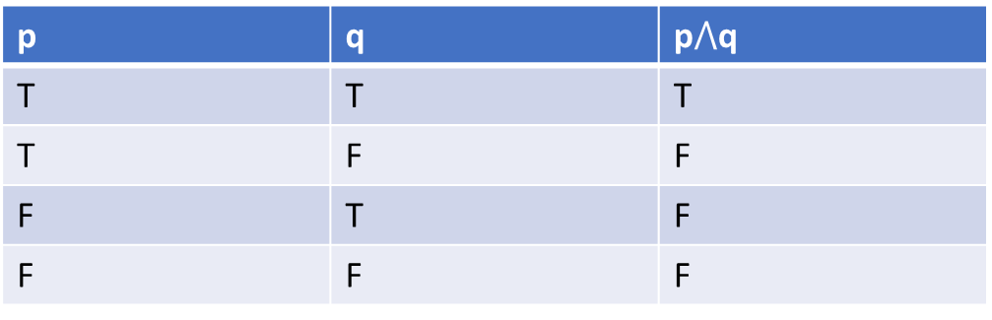
Question 1: A review of lectures
i. A statement or proposition is a sentence that is always true or false but not both.
ii. Conjunction
p | q | p$⋀$q
T | T | T
T | F | F
F | T | F
F | F | F

Slide 11
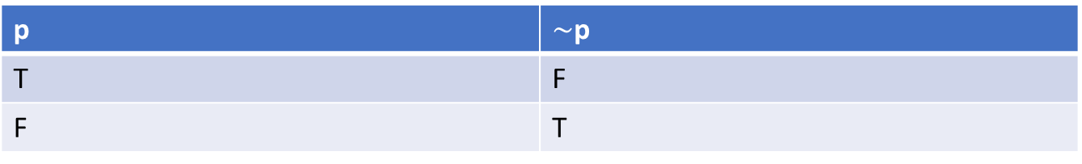
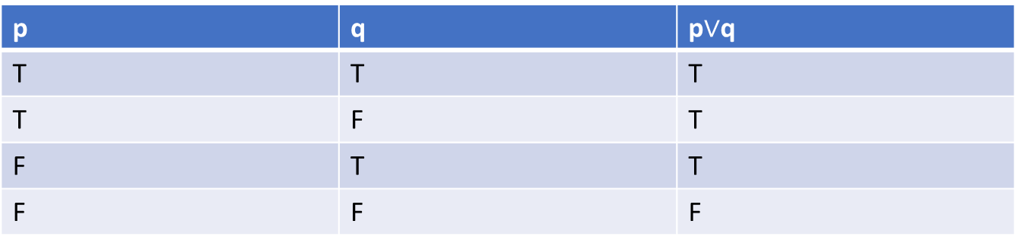
Question 1: A review of lectures
Disjunction
Negation
p | q | p$∨$q
T | T | T
T | F | T
F | T | T
F | F | F
p | $\sim$p
T | F
F | T

Slide 12
Sheet 1: Question 1
A warm-up.
Solution:
(i) (“(V, E) is an undirected graph” ∧ “(V, E) is connected” ∧ “(V, E) is acyclic”) → |E| = |V | − 1
(ii) “A \ B is countable” → (“A is countable” ∨ “B is uncountable”)
or
“A \ B is countable” → (“A is countable” ∨ ∼(“B is countable”))
(iii)* B ⊆ A → Prob(B) ≤ Prob(A)

Slide 13
Question 2: An easy question
Without looking at the answers that you’ve written for your homework, fill in the table for the following Negation laws.
(i) p∨ ∼ p ≡ t;
(ii) ∼ (∼ p) ≡ p;
(iii) p∧ ∼ p ≡ c;
(iv) ∼ t ≡ c.

Slide 14



Question 2: An easy question
$$p∨∼p≡t$$
p | $$\sim p$$ | p$∨\sim$p | t
T | F | T | T
F | T | T | T
$$∼(∼p)≡p$$
p | $$\sim p$$ | $$\sim (\sim P)$$
T | F | T
F | T | F

Slide 15
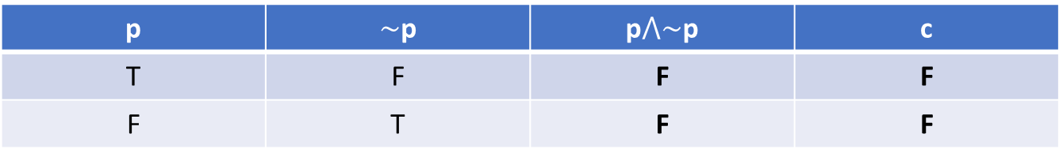


Question 2: An easy question
$p∧\sim p≡c$
$\sim t≡c$
p | $\sim$p | p$⋀\sim$p | c
T | F | F | F
F | T | F | F
t | $\sim$t | c
T | F | F

Slide 16
Sheet 1: Question 2
The rules governing the logic of compound statements. Memorize them!
Let p,q and r be arguments, t a tautology and c a contradiction.
The logical connective refers to conjunctions and disjunctions.
Rules set 1 (algebraic) |  |  | Notes
Commutativity | p ∧ q ≡ q ∧ p | p ∨ q ≡ q ∨ p | You can switch the order of arguments.
Associativity | (p ∧ q) ∧ r ≡ p ∧ (q ∧ r) | (p ∨ q) ∨ r ≡ p ∨ (q ∨ r) | If the logical connective is used consecutively you can apply them in any order.
Distributivity | p ∧ (q ∨ r) ≡ (p ∧ q) ∨ (p ∧ r) | p ∨ (q ∧ r) ≡ (p ∨ q) ∧ (p ∨ r) | You can “multiply” the argument and logical connective outside the bracket.

Slide 17
Sheet 1: Question 2
Rules set 2 |  |  | Notes
Idempotence | p ∧ p ≡ p | p ∨ p ≡ p | An argument acting on itself gives itself. Idempotence.
Absorption | p ∨ (p ∧ q) ≡ p | p ∧ (p ∨ q) ≡ p | A conjunction decreases the size of a truth set. A disjunction increases the size of a truth set. We can think of a conjunction of a minimum operator. We can think of a disjunction as a maximum operator.

Slide 18
Sheet 1: Question 2
Rules set 3 |  |  |  |  | Notes
De Morgan’s Law | ∼ (p ∧ q) ≡ (∼ p) ∨ (∼ q) | ∼ (p ∨ q) ≡ (∼ p) ∧ (∼ q) |  |  | Negations exchange conjunction and disjunctions.
Identity | p ∧ t ≡ p | p ∨ t ≡ t | p ∨ c ≡ p | p ∧ c ≡ c | An example of how conjunctions and disjunctions can be seen as max/min operations.
Negation | p∨ ∼ p ≡ t | ∼ (∼ p) ≡ p | p∧ ∼ p ≡ c | ∼ t ≡ c

Slide 19
Sheet 1: Question 2
These rules can be used to prove logical equivalences.
It is a better alternative then using truth tables for proofs for those who are careless.
There are obvious parallels between the rules above and the rules of set theory.

Slide 20
Sheet 1: Question 2
Let’s prove these rules.
Commutativity and associativity are easy.

Slide 21
Sheet 1: Question 2
Distributivity : p ∨ (q ∧ r) ≡ (p ∨ q) ∧ (p ∨ r) .
p | q | r | q ∧ r | p ∨ (q ∧ r) | p ∨ q | p ∨ r | (p ∨ q) ∧ (p ∨ r)
T | T | T | T | T | T | T | T
T | F | T | F | T | T | T | T
F | T | T | T | T | T | T | T
F | F | T | F | F | F | T | F
T | T | F | F | T | T | T | T
T | F | F | F | T | T | T | T
F | T | F | F | F | T | F | F
F | F | F | F | F | F | F | F

Slide 22
Sheet 1: Question 2
The absorption and identity rules are easy to show.

Slide 23
Sheet 1: Q2
DeMorgan’s law: ∼ (p ∧ q) ≡ (∼ p) ∨ (∼ q)
p | q | ∼ p | ∼ q | (∼ p) ∨ (∼ q) | (p ∧ q) | ∼ (p ∧ q)
T | T | F | F | F | T | F
T | F | F | T | T | F | T
F | T | T | F | T | F | T
F | F | T | T | T | F | T

Slide 24
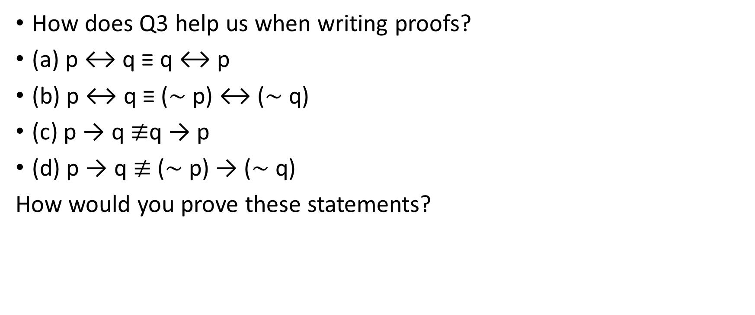
Question 3: A bit more thought
How does Q3 help us when writing proofs?
(a) p ↔ q ≡ q ↔ p
(b) p ↔ q ≡ (∼ p) ↔ (∼ q)
(c) p → q $≢$q → p
(d) p → q $≢$ (∼ p) → (∼ q)
How would you prove these statements?

Slide 25

Sheet 1: Question 3
(a) p ↔ q ≡ q ↔ p
$p↔q$
$≡\left(p→q\right)⋀\left(q→p\right)$ (Definition)
$≡\left(q→p\right)⋀\left(p→q\right)$ (Commutativity)
$≡q↔p$ (Definition)

Slide 26
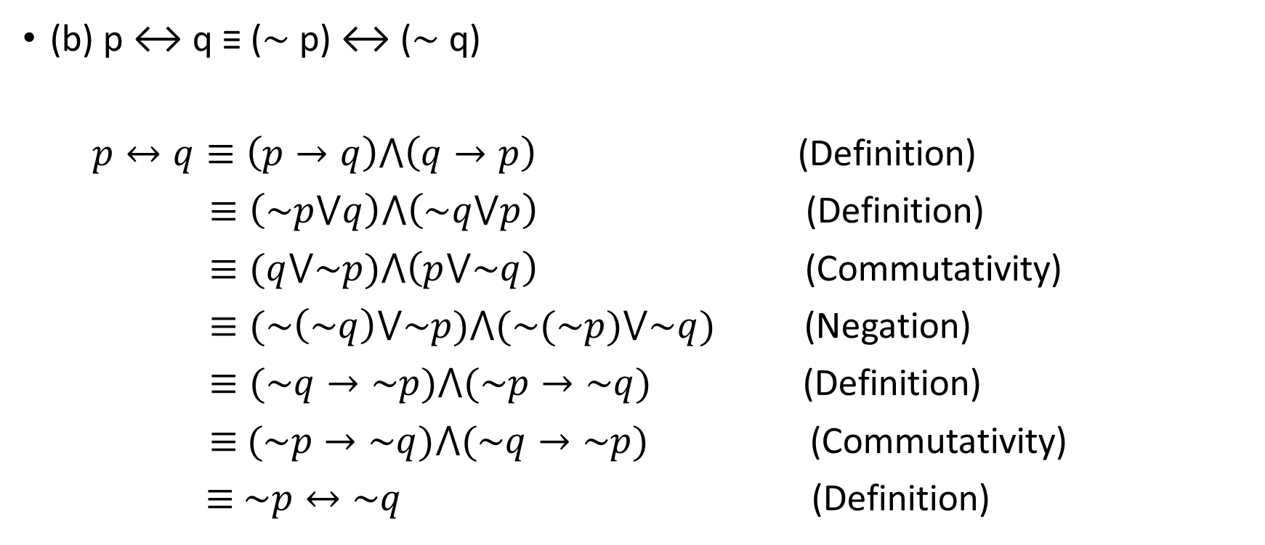
Sheet 1: Q3
(b) p ↔ q ≡ (∼ p) ↔ (∼ q)
$p↔q≡\left(p→q\right)⋀\left(q→p\right)$ (Definition)
$≡\left(\sim p⋁q\right)⋀\left(\sim q⋁p\right)$ (Definition)
$≡(q⋁\sim p)⋀\left(p⋁\sim q\right)$ (Commutativity)
$≡(\sim \left(\sim q\right)⋁\sim p)⋀(\sim (\sim p)⋁\sim q)$ (Negation)
$≡(\sim q→\sim p)⋀(\sim p→\sim q)$ (Definition)
$≡$ $(\sim p→\sim q)⋀(\sim q→\sim p)$ (Commutativity)
$≡$ $\sim p↔\sim q$ (Definition)

Slide 27
Sheet 1: Question 3
Use truth tables to disprove (c) and (d).

Slide 28
Sheet 1: Question 3
To show that two statements are logically equivalent we can either use truth tables or the rules of logic we proved earlier (usually easier).
To show that two statements are not logically equivalent we use truth tables.

Slide 29
Sheet 1: Question 4
Which of the following pairs are equivalent?
(i) p ∨ (q → r) and (p ∨ q) → (p ∨ r)
(ii)(p ∧ q) → r and (p → r) ∧ (q → r)

Slide 30
Sheet 1: Question 4
To tackle what is essentially a true or false questions first start with test cases.

Slide 31
Sheet 1: Question 4
p ∨ (q → r) and (p ∨ q) → (p ∨ r)
Lets try a test case.
p: It is raining
q: You like it
r: You should put a ring on it
p ∨ (q → r): It’s raining or if you like it then you should put a ring on it.
(p ∨ q) → (p ∨ r): If it’s raining or you like it then it’s raining or you should put a ring on it.

Slide 32
Sheet 1: Question 4
True.
(p ∨ q) → (p ∨ r) ≡ (∼ (p ∨ q)) ∨ (p ∨ r) (Definition)
≡ ((∼ p) ∧ (∼ q)) ∨ (p ∨ r) (DeMorgan’s Law)
≡ ((∼ p) ∨ (p ∨ r)) ∧ ((∼ q) ∨ (p ∨ r)) (Distribution Law)
≡ T∧ ((∼ q) ∨ (p ∨ r)) (Negation Law)
≡ (∼ q) ∨ (p ∨ r) (Identity Law)
≡ p ∨ (∼ q ∨ r) (Associativity Law)
≡ p ∨ (q → r) (Definition)

Slide 33
Sheet 1: Question 4 (Participation)
(b) (ii)(p ∧ q) → r and (p → r) ∧ (q → r)
False.
Can somebody give me a test case?
Use truth tables to prove this.

Slide 34
Sheet 1: Question 5
Prove that the following are tautologies
(a)(p ∧ q) → p (Specialization)
(b)((p ∨ q)∧ ∼ p) → q (Elimination)
(c) ((p → q) ∧ p) → q (Modus ponens)
(d) ((p → q)∧ ∼ q) →∼ p (Modus tollens)
(e) (∼ p → (q∧ ∼ q)) → p (Contradiction rule)
(f) ((p → q) ∧ (q → r)) → (p → r) (Transitivity)

Slide 35
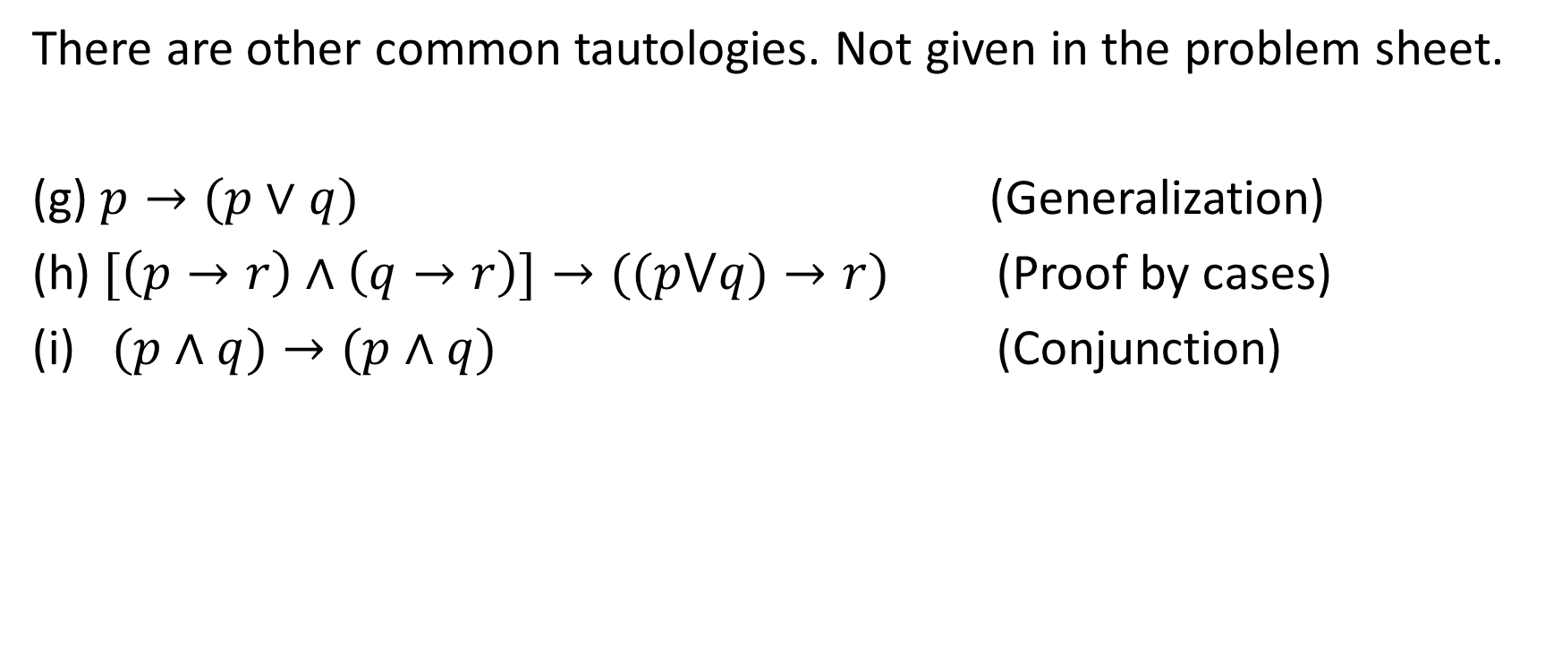
Sheet 1: Question 5
There are other common tautologies. Not given in the problem sheet.
(g) $p→(p∨q)$ (Generalization)
(h) $[\left(p→r\right)∧\left(q→r\right)]→((p⋁q)→r)$ (Proof by cases)
(i) $(p∧q)→(p∧q)$ (Conjunction)

Slide 36
Sheet 1: Question 5
These are 6 examples of logical arguments.
You may employ any of these 6 arguments to prove results.
I don’t recommend memorising these arguments. They will come to you naturally after writing many proofs.

Slide 37
Question 5: A harder question
Using the laws of logic from Q2 of the problem sheet, prove that the following statements are tautologies.
(b) ((p ∨ q)∧ ∼ p) → q
(f) ((p → q) ∧ (q → r)) → (p → r)
You’ll need state which law you’ve used whenever you’ve done so.

Slide 38
Question 5
(b) ((p ∨ q)∧ ∼ p) → q

Slide 39
Sheet 1: Question 5
(b)((p ∨ q)∧ ∼ p) → q (Elimination)
((p ∨ q)∧ ∼ p) → q ≡∼ ((p ∨ q)∧ ∼ p) ∨ q (Definition)
≡ (∼ (p ∨ q)) ∨ (p ∨ q) (DeMorgan’s law)
≡ T. (Negation law)

Slide 40
Question 5
(f) ((p → q) ∧ (q → r)) → (p → r)

Slide 41
Sheet 1: Question 5
(f) ((p → q) ∧ (q → r)) → (p → r) ≡ T (Transitivity)
((p → q) ∧ (q → r)) → (p → r)
≡∼ ((p → q) ∧ (q → r)) ∨ (p → r) (Definition)
≡ (∼ (p → q) ∨ (∼ (q → r)) ∨ (p → r) (DeMorgan’s Law)
≡ (∼ (∼ p ∨ q)) ∨ (∼ (∼ q ∨ r)) ∨ (∼ p ∨ r) (Definition)
≡ (p∧ ∼ q) ∨ (q∧ ∼ r) ∨ (∼ p) ∨ r (DeMorgan’s Law)
≡ (((p∧ ∼ q) ∨ (∼ p)) ∨ ((q∧ ∼ r) ∨ r) (Commutativity Law)
≡ ((p∨ ∼ p) ∧ ((∼ q) ∨ (∼ p))) ∨ ((q ∨ r) ∧ ((∼ r) ∨ r) (Distributivity Law)
≡ (∼ q) ∨ (∼ p) ∨ q ∨ r (Negation Law)
≡ ((∼ q) ∨ q) ∨ (∼ p) ∨ r (Commutativity Law)
≡ T ∨ (∼ p) ∨ r (Negation Law)
≡ T. (Identity Law)

Slide 42
Sheet 1: Question 5
(a) (a)(p ∧ q) → p ≡ T (Specialization)
(p ∧ q) → p ≡∼ (p ∧ q) ∨ p (Definition)
≡ ((∼ p) ∨ (∼ q) )∨ p (DeMorgan’s law)
≡ ((∼ p) ∨ p) ∨ (∼ q) (Distribution law)
≡ T ∨ (∼ q) (Negation law)
≡ T. (Identity law)

Slide 43
Sheet 1: Question 5
(c) ((p → q)∧p) → q ≡T (Modus Ponens)
((p → q)∧p) → q ≡∼ ((p → q)∧p)∨q (Definition)
≡ (∼ (p → q))∨((∼ p)∨q) (Associativity law)
≡ (∼ (p → q))∨(p → q) (Definition)
≡ T. (Negation law)

Slide 44
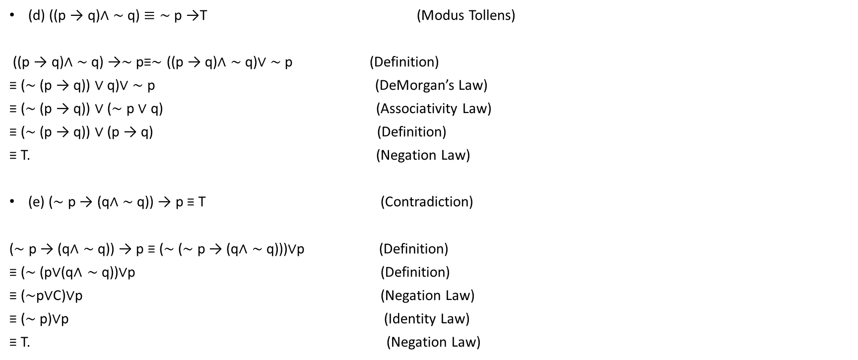
Sheet 1: Question 5
(d) ((p → q)∧ ∼ q) $≡\sim$ p →T (Modus Tollens)
((p → q)∧ ∼ q) →∼ p≡∼ ((p → q)∧ ∼ q)∨ ∼ p (Definition)
≡ (∼ (p → q)) ∨ q)∨ ∼ p (DeMorgan’s Law)
≡ (∼ (p → q)) ∨ (∼ p ∨ q) (Associativity Law)
≡ (∼ (p → q)) ∨ (p → q) (Definition)
≡ T. (Negation Law)
(e) (∼ p → (q∧ ∼ q)) → p ≡ T (Contradiction)
(∼ p → (q∧ ∼ q)) → p ≡ (∼ (∼ p → (q∧ ∼ q)))∨p (Definition)
≡ (∼ (p∨(q∧ ∼ q))∨p (Definition)
≡ (∼p∨C)∨p (Negation Law)
≡ (∼ p)∨p (Identity Law)
≡ T. (Negation Law)

Slide 45
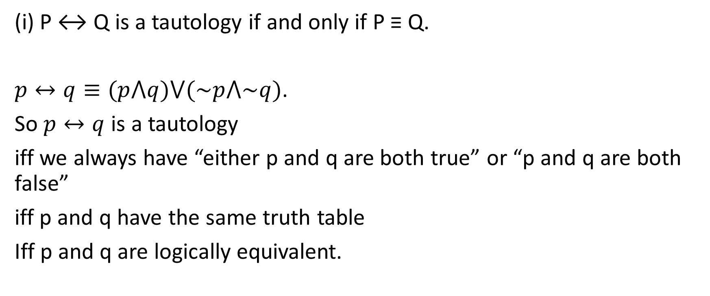
Sheet 1: Question 6
(i) P ↔ Q is a tautology if and only if P ≡ Q.
$p↔q≡(p⋀q)⋁(\sim p⋀\sim q)$.
So $p↔q$ is a tautology
iff we always have “either p and q are both true” or “p and q are both false”
iff p and q have the same truth table
Iff p and q are logically equivalent.

Slide 46

Sheet 1: Question 6
(ii) If P$≡Q$ then $\sim$P$≡\sim$Q.
P$≡Q$
iff (P is true iff Q is true)
iff (P is false iff Q is false)
iff ($\sim$P is true iff $\sim$Q is true)
So, $\sim$P$≡\sim$Q.

Slide 47
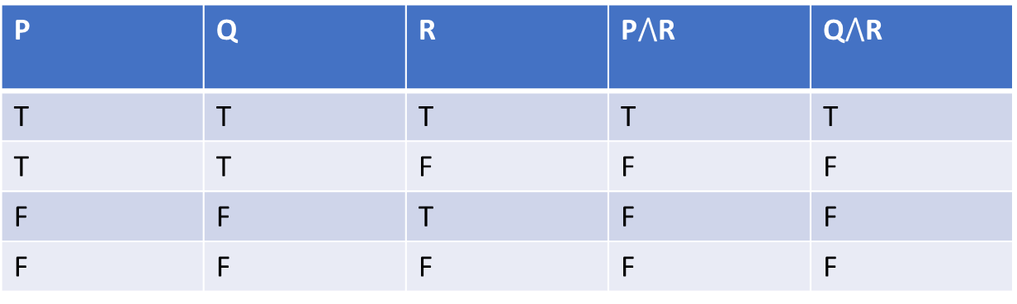

Sheet 1: Question 6
(iii) If P$≡Q$ then $P∧R≡Q∧R$ .
P | Q | R | P$⋀$R | Q$⋀$R
T | T | T | T | T
T | T | F | F | F
F | F | T | F | F
F | F | F | F | F

Slide 48
Sheet 1: Question 7
A question to convince you why the implication connective is appropriately defined in order for us to reason deductively using transitivity.
Use Truth tables.
p | q | r | p$→$q | q$→$r | p$→$r | (p$→$q)$⋀$(q$→$r) | ((p$→$q)$∧$(q$→$r))$→$(p$→$r)
T | F | T | F | F | T | F | F

Slide 49
Sheet 1: Question 8
An exercise on universal and existential quantifiers and their negations.
I’ll leave you to check the solutions on the sheet.

Slide 50
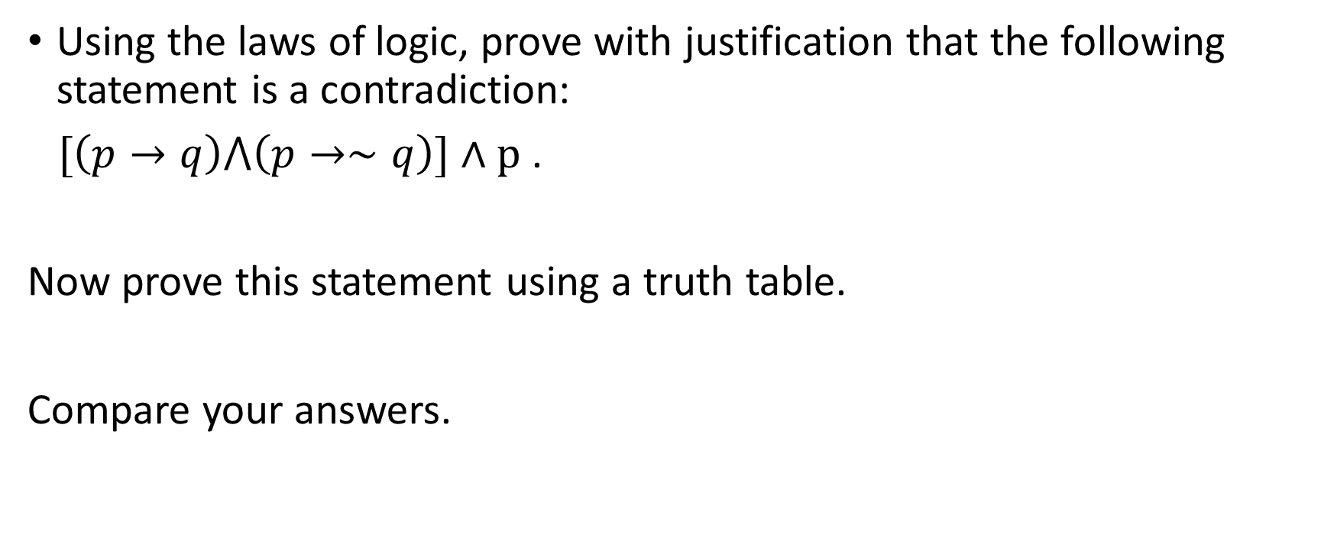
Question 9: A new problem
Using the laws of logic, prove with justification that the following statement is a contradiction:
$[\left(p→q\right)⋀\left(p→∼q\right)]∧p$ .
Now prove this statement using a truth table.
Compare your answers.

Slide 51

Question 10: Food for thought (2 mins)
i. Prove that $\left(p →\sim p\right)≡\sim p.$
ii. Explain why this makes sense.

Slide 52
Question 11: Putting it all together
Below is a list of few a proofs. Let’s describe the structure of the proofs.
We work on examples from number theory.

Slide 53
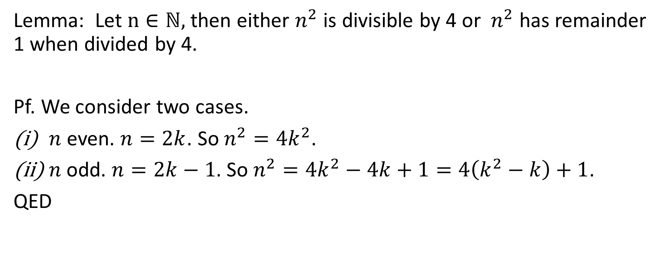
Question 11: Putting it all together
Lemma: Let $n∈ℕ,$ then either $n^{2}$ is divisible by 4 or $n^{2}$ has remainder 1 when divided by 4.
Pf. We consider two cases.
$n$ even. $n=2k$. So $n^{2}=4k^{2}$.
$n$odd. $n=2k−1$. So $n^{2}=4k^{2}−4k+1=4\left(k^{2}−k\right)+1$.
QED

Slide 54
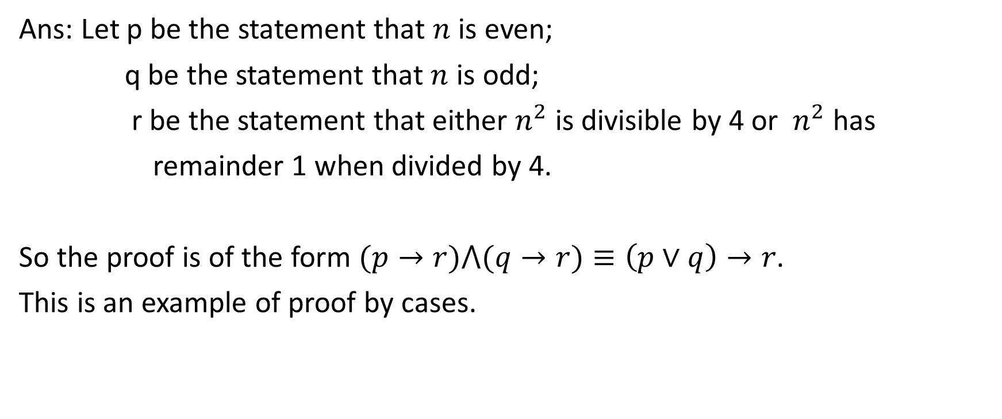
Question 11: Putting it all together
Ans: Let p be the statement that $n$ is even;
q be the statement that $n$ is odd;
r be the statement that either $n^{2}$ is divisible by 4 or $n^{2}$ has
remainder 1 when divided by 4.
So the proof is of the form $(p→r)⋀(q→r)≡\left(p∨q\right)→r$.
This is an example of proof by cases.

Slide 55
Question 11: Putting it all together
i. Definition: A prime is an integer greater that 1 whose only factors are 1 and itself.
Definition: Any integer greater than 1 that is not a prime is
composite.

Slide 56
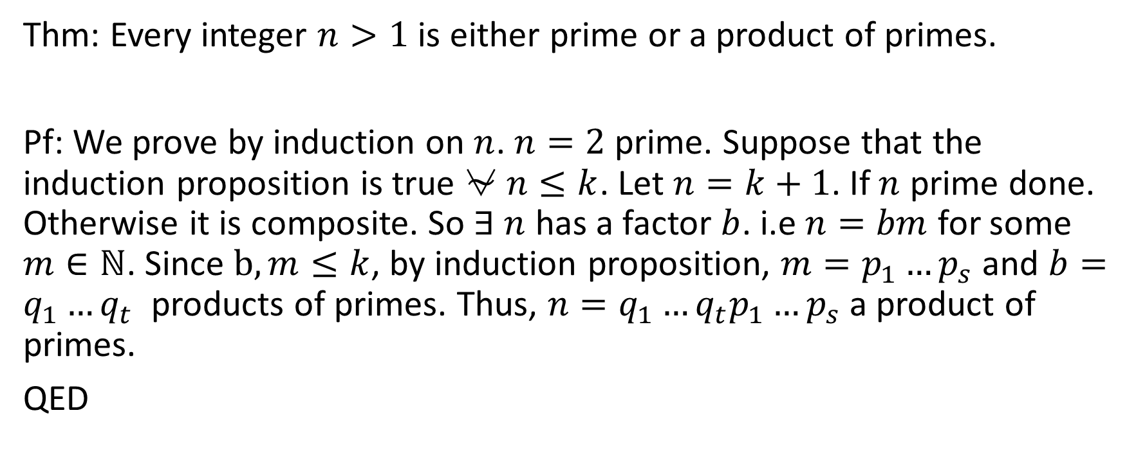
Question 11: Putting it all together
Thm: Every integer $n>1$ is either prime or a product of primes.
Pf: We prove by induction on $n$. $n=2$ prime. Suppose that the induction proposition is true ⍱ $n≤k$. Let $n=k+1$. If $n$ prime done. Otherwise it is composite. So $∃$ $n$ has a factor $b$. i.e $n=bm$ for some $m∈ℕ$. Since $b,m≤k$, by induction proposition, $m=p_{1}…p_{s}$ and $b=q_{1}…q_{t}$ products of primes. Thus, $n={q_{1}…q}_{t}p_{1}…p_{s}$ a product of primes.
QED

Slide 57
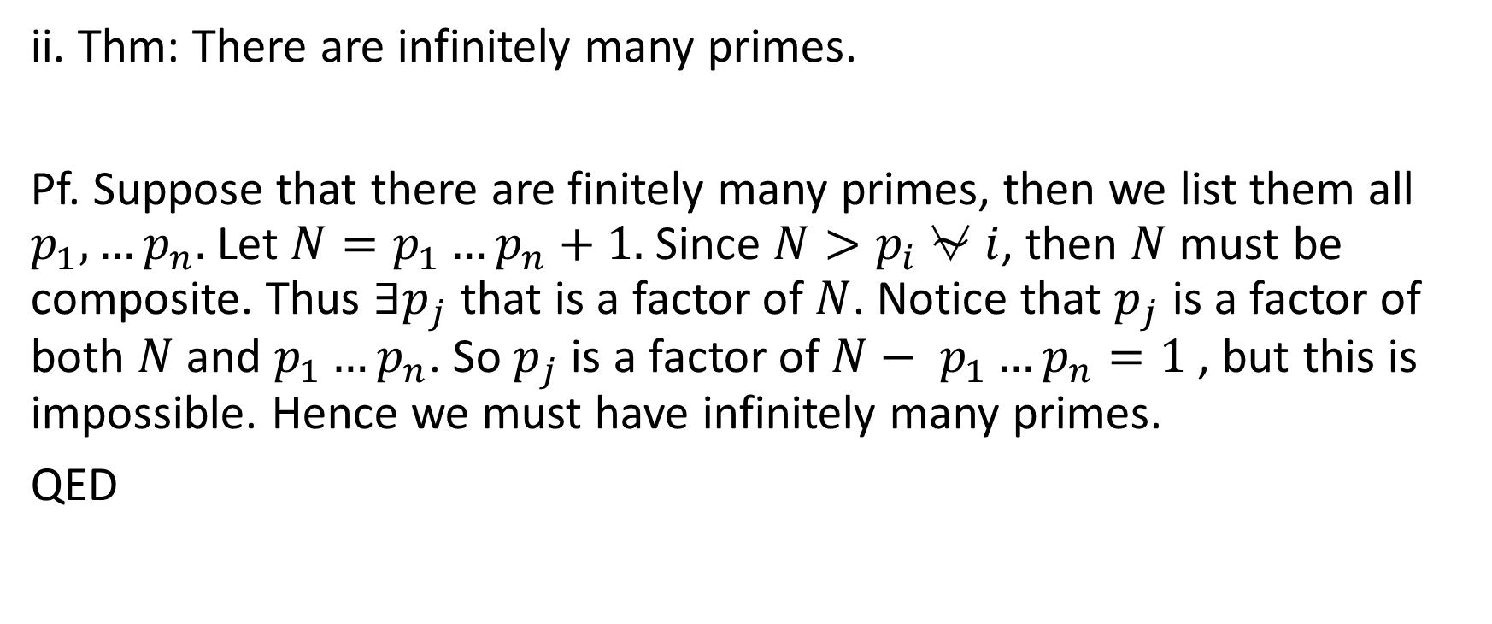
Question 11: Putting it all together
ii. Thm: There are infinitely many primes.
Pf. Suppose that there are finitely many primes, then we list them all $p_{1},…p_{n}.$ Let $N=p_{1}…p_{n}+1.$Since $N>p_{i}$⍱ $i$, then $N$ must be composite. Thus $∃p_{j}$ that is a factor of $N$. Notice that $p_{j}$ is a factor of both $N$ and $p_{1}…p_{n}$. So $p_{j}$ is a factor of $N−$ $p_{1}…p_{n}=1$, but this is impossible. Hence we must have infinitely many primes.
QED

Slide 58

Question 11: Putting it all together
Ans: Let p be the statement that there are infinitely many primes;
$$\sim p→c$$

Slide 59
Questions

